Slide 1
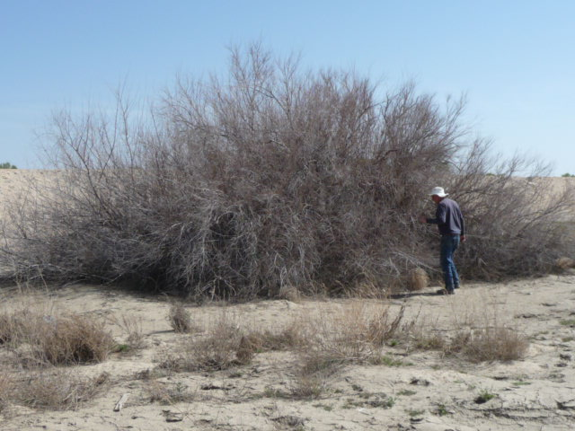
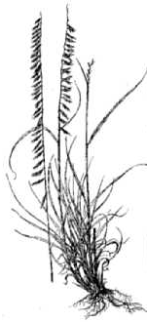
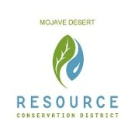
Complexity and Constraints of
Tamarisk Treatment in the Mojave River Watershed
Ken Lair, Lair Restoration Consulting
Hesperia, CA
Chuck Bell and Jackie Lindgren,
Mojave Desert Resource Conservation District
Victorville, CA
Tamarisk Coalition
2016 Annual Conference
Grand Junction, CO
February 10, 2016

Slide 2
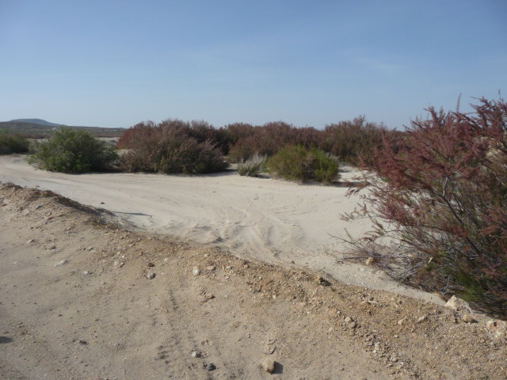
Tamarisk species effects – two (possibly three) species –
Tamarix ramosissima, T. parviflora, T. chinensis
– with possible hybrids between these species.
– different phenological maturation rates.
Tamarix ramosissima
Tamarix parviflora
Mojave River watershed dynamics
Significant fall in elevation, from Mojave Forks to Barstow, yielding significant
differences in riverine micro-climate.
Significant changes in geology affecting both micro-climate (e.g., Mojave
Narrows), and particularly groundwater depth.
Geologic “sills” at Mojave Narrows and Camp Cady
Other areas without sills, keeping groundwater at deeper depths.
Different optimum herbicidal treatment timing
T. parviflora – earlier
T. ramosissima / chinensis – later
Requirement to spray after September 15 to avoid bird nesting period
necessitates late treatment, which is not optimum for T. parviflora.
Possible differential herbivory by Diorhabda species (if and when introduced).

Slide 3
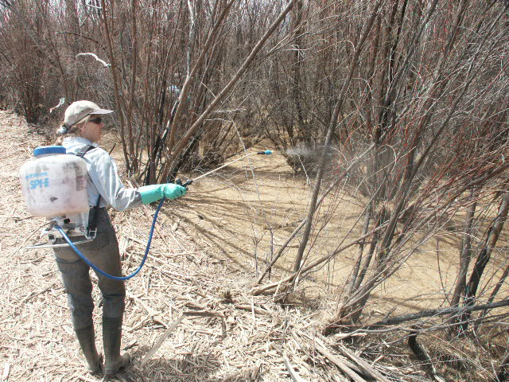
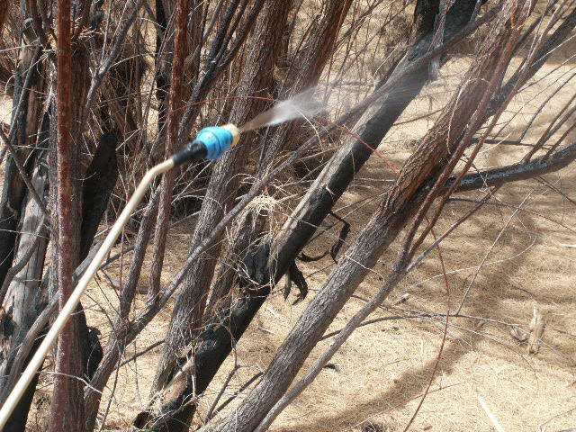
Diurnal timing effects on foliar spraying
Southwest desert environment (heat and aridity) affects
optimum timing during the day for foliar spraying
Chemical volatilization – increases herbicide “lift and drift”
Tamarisk stomatal opening reduction or restriction above
90ºF – reduces atmospheric exchange – reduces herbicide
uptake.
Applicator constraints -- work limited hours (early, partial
days) during hotter air temperatures.

Slide 4
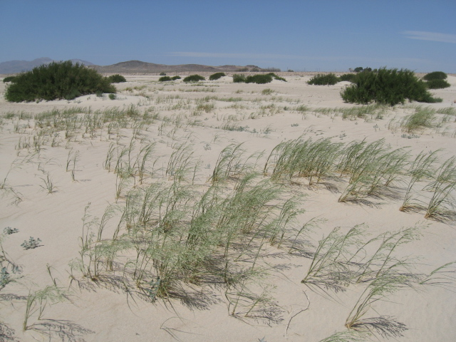
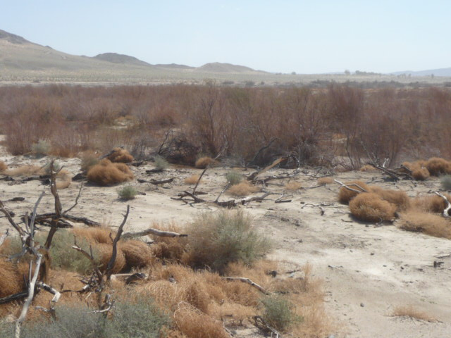
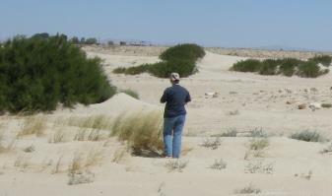
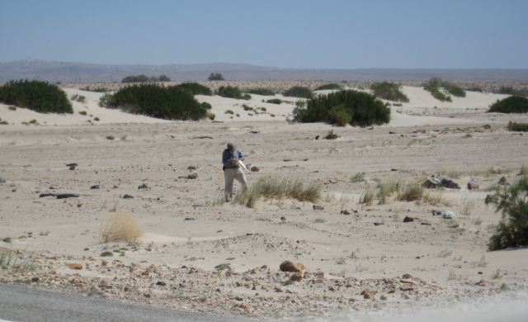
Plant morphological effects
Scattered, patchy stand distribution – increased time and labor for coverage.

Slide 5
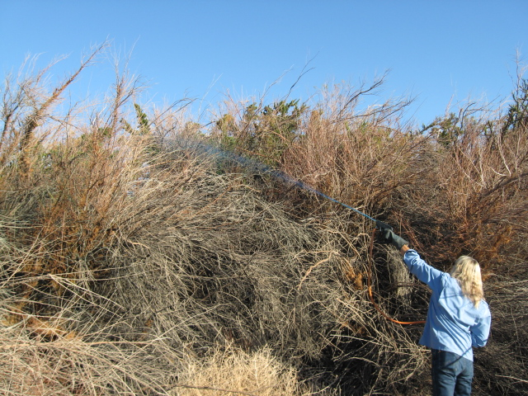
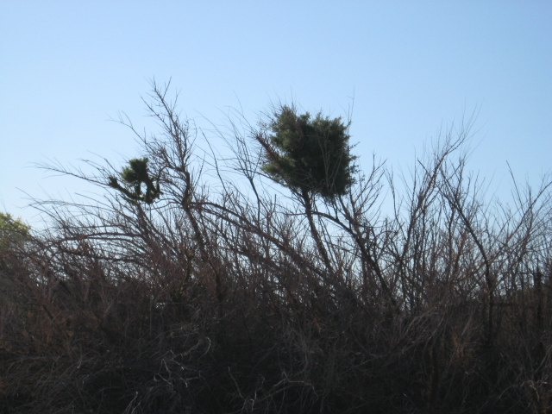
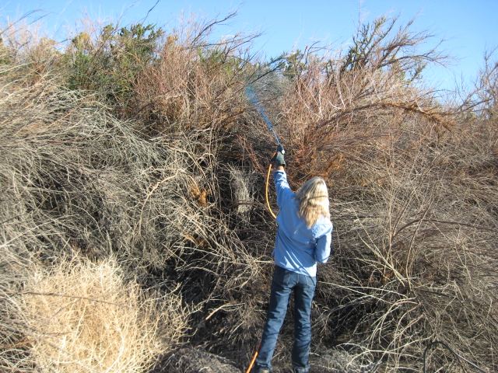
Individually large, clonal (“clumpy”) plants, with
layered canopies and very high canopy volume
(laterally and vertically).
Increased time, labor, materials, and need for
higher pressure sprayer technology for full
canopy coverage with foliar techniques.
Nearly impossible to conduct basal bark treatment
due to limited access to plant interiors.
Increased time, labor, and materials for full coverage
with cut-stump techniques.

Slide 6
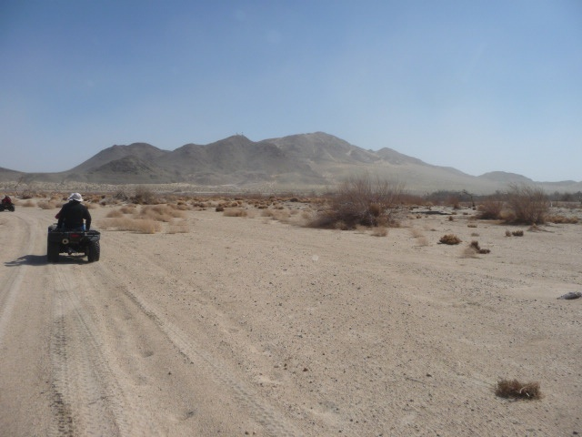
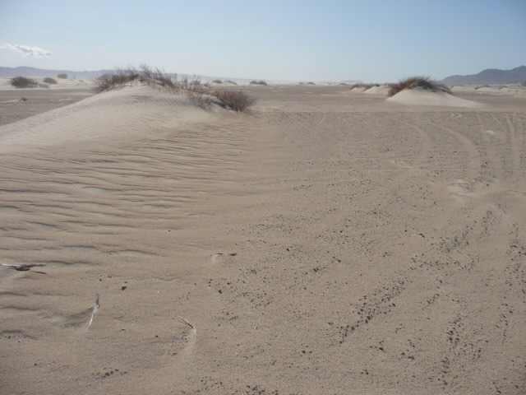
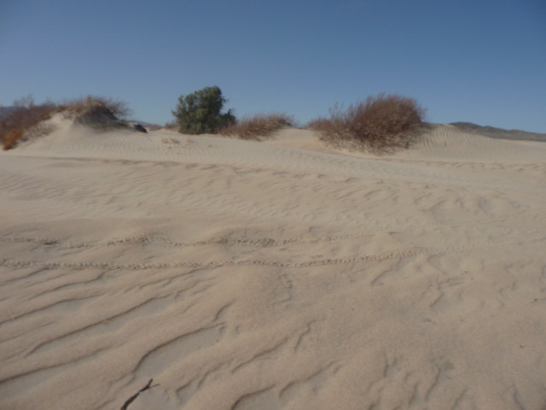
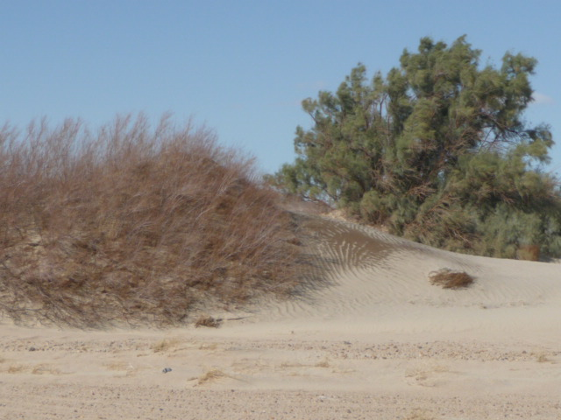
Soil effects
Very sandy streambed and riparian soils, resulting from stream flow dynamics and
localized high wind erosion impacts.
Limits equipment access.
Increases water infiltration and deep percolation, while lowering water holding
capacity in the root zone.
Reduces plant vigor and atmospheric exchange, reducing herbicide uptake.
Reduces vigor and competiveness of associated desirable vegetation.
Soil and climate interaction makes tamarisk distribution and morphology even
more patchy and clumpy.
Creates constraints relative to preservation of:
Aesthetics for adjacent landowners.
Streambank and flood control berm stabilization and maintenance.
Difficult to maintain sufficient cover of desirable species to reduce erosion.

Slide 7
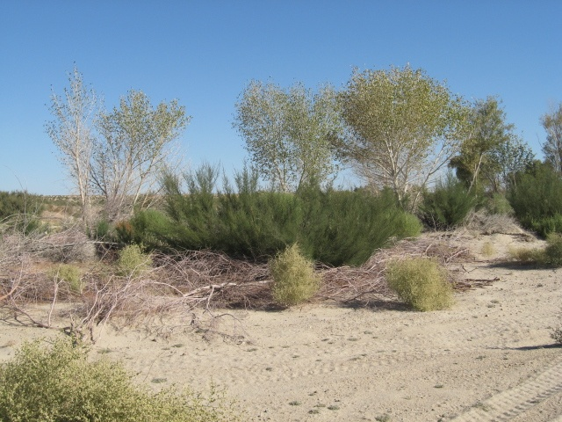
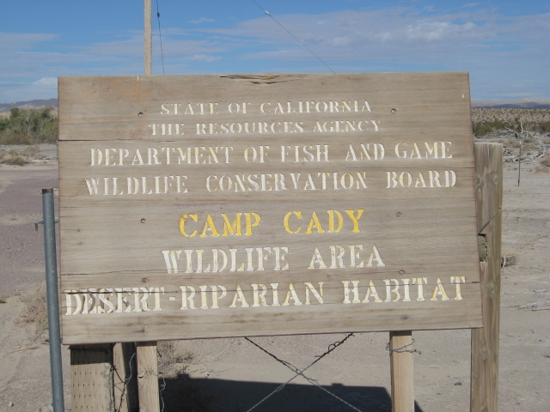
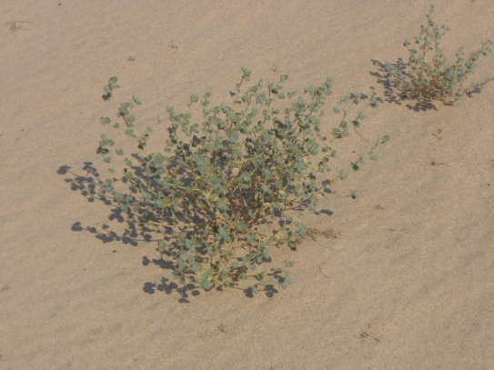
Habitat effects
Potential Southwestern willow flycatcher (SWF) habitat at Mojave Narrows and
Camp Cady. If so designated in the future, represents technical and political issues
that might limit options for controlling tamarisk.
Dunes formed below tamarisk are habitat for potentially sensitive species such as
desert panicgrass (Panicum urvilleanum) and desert twinbugs (Dicoria canescens).

Slide 8
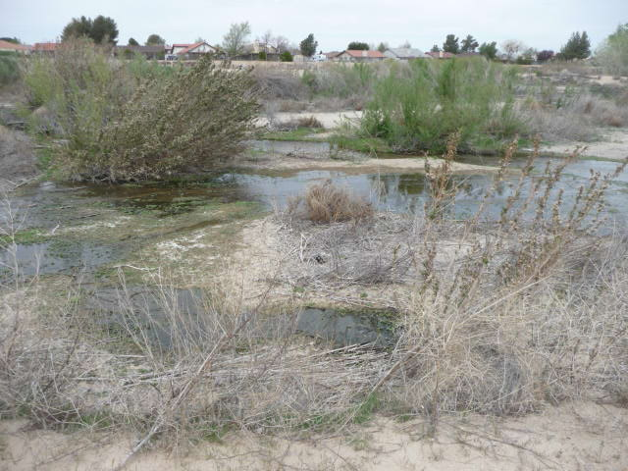
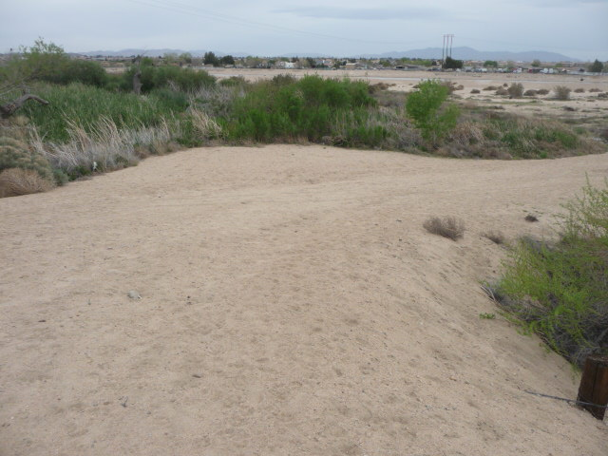
Water conservation, salvage, and recharge effects / issues
Effluent and aquifer recharge discharge sites into the Mojave River increase islands
of tamarisk establishment, propagule dissemination, and stand expansion.
CDFW Fishery discharge site [up to 8,000,000 gallons (~25 ac-ft) per day].
MWA aquifer recharge sites (2).
Victor Valley Wastewater Reclamation Authority and Barstow water treatment
ponds and discharge sites.
Mojave Water Agency – large $$$ and priority consideration – tamarisk control for
groundwater salvage.
Mitigation properties (COE, CDFW, SBCO, and private developers) -- $$$ and priority
consideration – tamarisk control for habitat improvement.

Slide 9
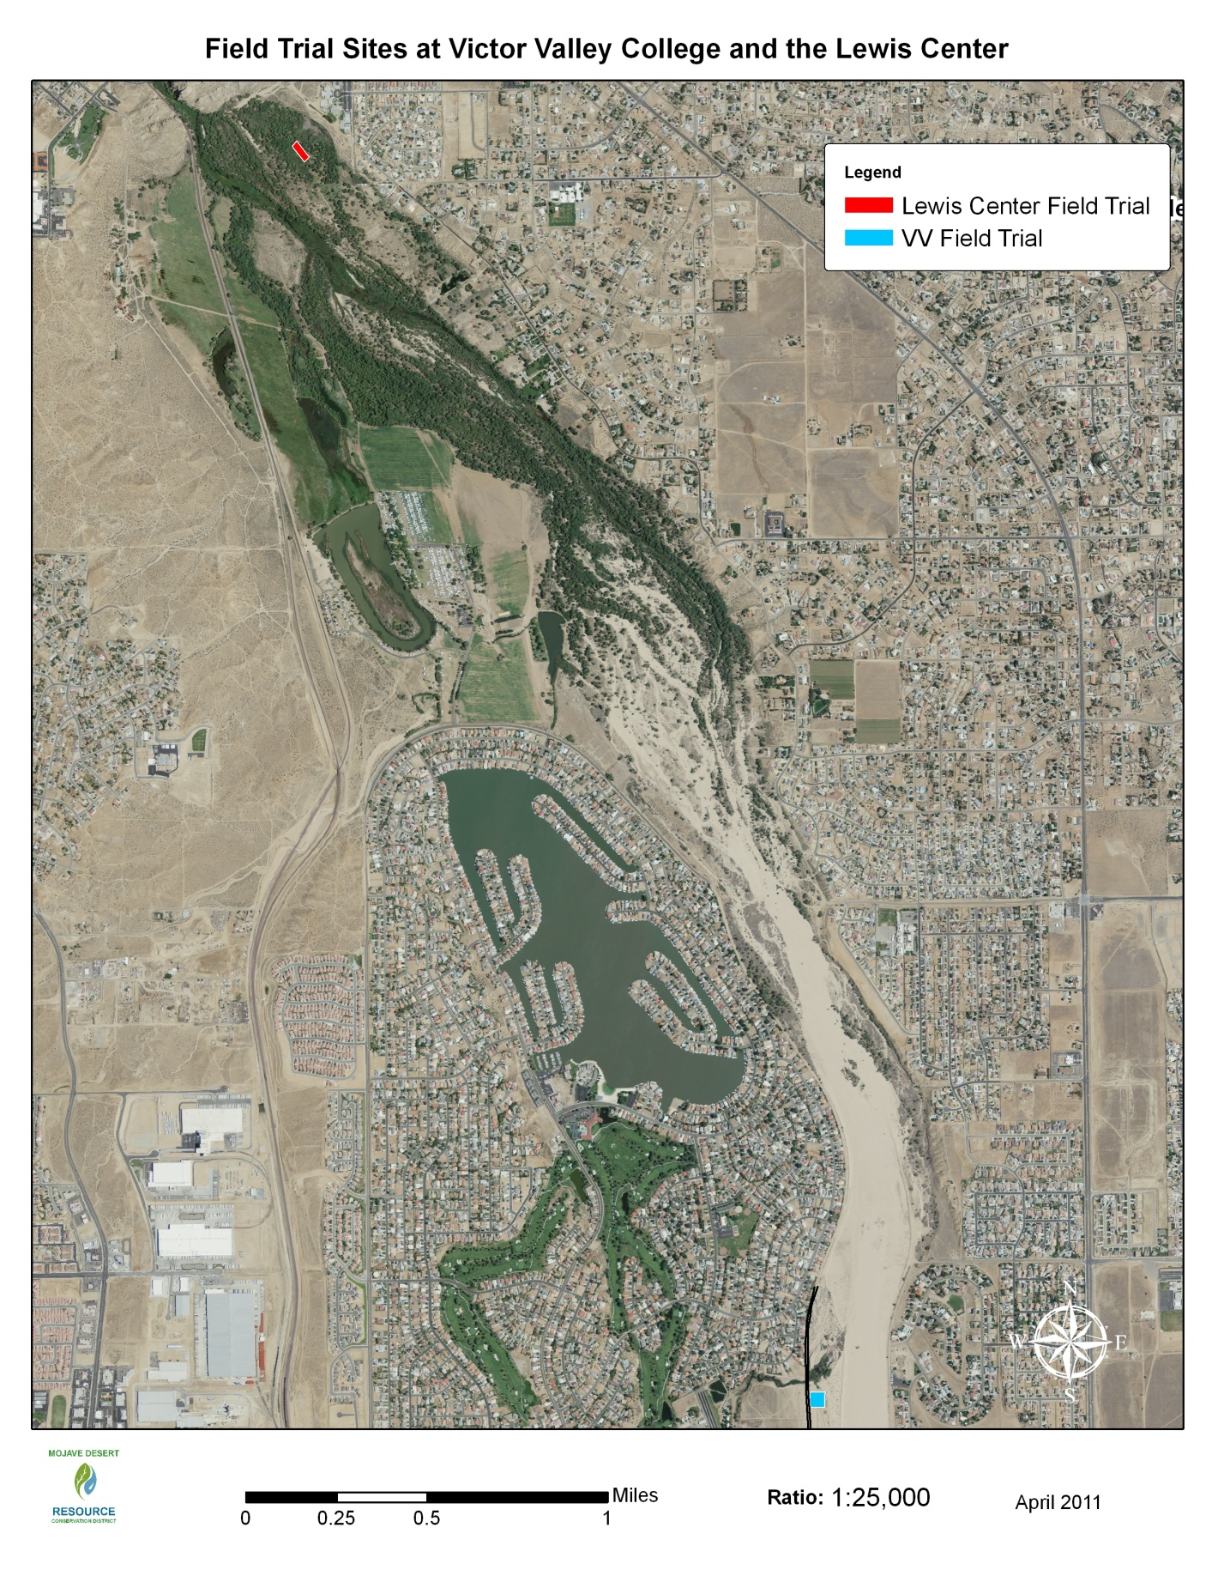
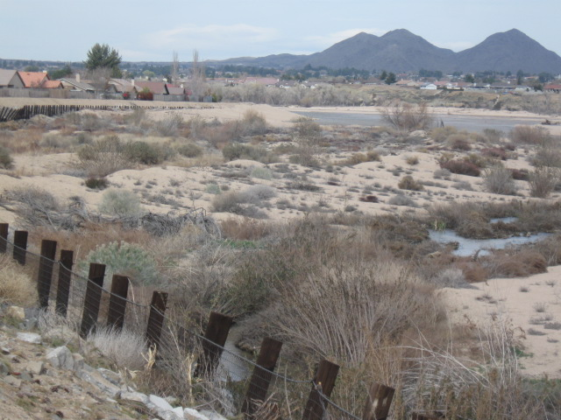
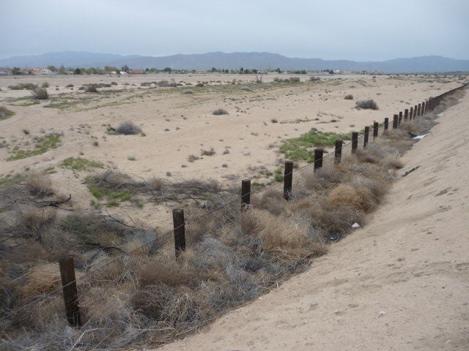
Multiple land ownership types
Must be coordinated for effective, cross-
boundary treatment
Over 600 private landowners
County land ownership by SBCO Flood
Control District (no phreatophytes)
Federal land ownership by BLM
State land ownership by CDFW
Mitigation properties under the
management of SBCO, CDFW, USFWS,
and COE
Coordination of funding mechanisms
between CDFW, MWA, and MDRCD

Slide 10
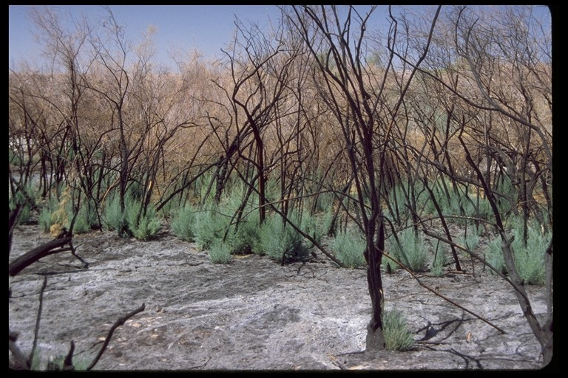
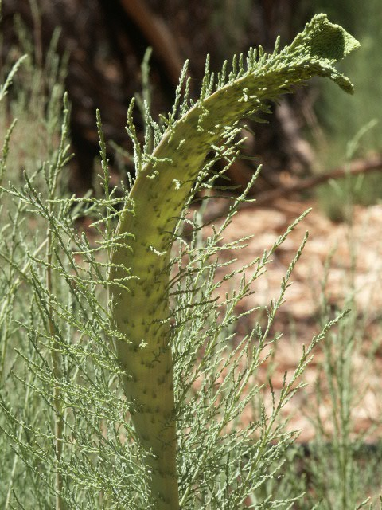
Occasional saltcedar genetic mutations after fire injury –
Stem and leaf coalescence into fans;
Plants develop resistance to certain
types of herbicide treatment.
Not supported by scientific study, but experience indicates it occurs occasionally following plant injury by fire.
“Cobra stems”

Slide 11
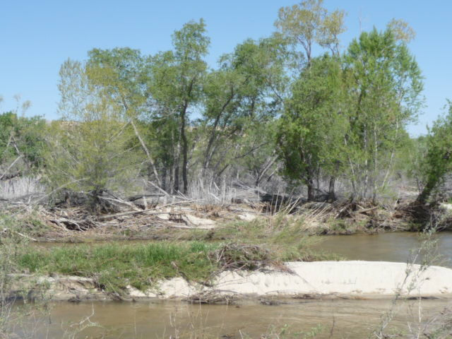
Given all these constraints,
The MDRCD and MWA have accomplished approximately 90% control of
saltcedar in the Upper and Middle Mojave River system (approximately 60
river miles) – outside of established protection zones related to erosion control
and/or landowner non-consents.
A total of 1,800 actual infestation acres have been treated across multiple land
ownerships, over an 8-year program, costing approximately $3,000,000.
Water salvage is estimated at approximately 0.8 acre-feet per acre of saltcedar
actual canopy area treated per year (Neale et al. 2011) ¹.
Approximately 5,000 acres of river channel and riparian zones have been
naturally restored to predominantly native species through release of competition
with saltcedar, in combination with reduced agricultural irrigation withdrawal
from the river system.
¹ Neale, C.M., S. Taghvaeian, H. Geli, S. Sivarajan, A. Masih, R. Pack, A. Witheral, S. O’Meara, and R. Simms. 2011. Evapotranspiration water use analysis of saltcedar and other vegetation in the Mojave River floodplain, 2007 and 2010. Mojave Water Agency Water Supply Management Study, Phase I Report. Department of Civil and Environmental Engineering, Utah State University, Logan, UT; and Bureau of Reclamation, Temecula, CA.

